Slide 1
PREGNANCY
INSTITUTION AFFILIATION
STUDENTS’ NAME
DATE OF PRESENTATION

Slide 2
ABSTRACT
This presentation provides information about having a healthy pregnancy period.
Pregnancy increases the risk of recurrent bacteria and other dangerous diseases that are associated with significant maternal and fetal risks.
Therefore, it is a critical period in women that requires maximum protection and care. This is to help and ensure a safe and healthy prenatal development.
All these pregnancy safety measures can be achieved through; clinical presentation, carrying out pregnancy diagnostic test, pathology test and carrying out pregnancy prognosis test.

Slide 3
Photo and Personal Biography

Slide 4
Clinical Presentation of Pregnancy
Pregnancy poses a higher risk of bacteriuria and dangerous diseases that create significant maternal and fetal risks.
The prevalence of bacteriuria varies across the world. According to Tchente et al. 2019, clinical diagnosis is crucial as it is usually done for the regular physiological changes during pregnancy.
Pregnant women with bacteriuria are likely to give birth to premature infants or even low-birth-weight infants’ therefore increasing neonatal mortality and morbidity.

Slide 5
CONT..
If the condition goes untreated, the majority of pregnant women are like to develop asymptomatic urinary tract infection (cystitis and pyelonephritis) (Tchente et al. 2019).
Getting early and regular prenatal care improves the chances of a healthy pregnancy.
This care can begin even before pregnancy with a preconception care visit to a health care provider.
Additionally, visiting the clinic during pregnancy does involve not only medical care but also other vital aspects like education on pregnancy and childbirth as well as appropriate guidance and counselling support.

Slide 6
CONT..
The information presented by Cleveland Clinic, (2019) suggests that pregnant women should visit the clinic regularly.
The visits gives their respective clinical officers a clear checkup of her condition as well as that of the baby.
It also offers pregnant women an oversight about the state of the health and the progress about the development of the baby.
Clinical visits also give them a more significant opportunity to ask various questions that concerns them.

Slide 7
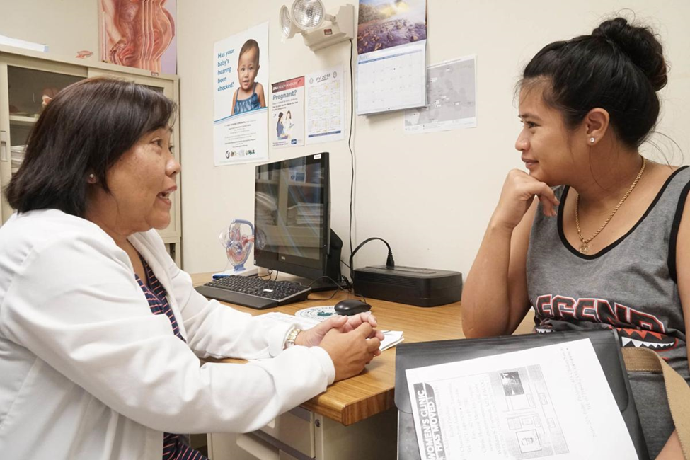
The diagram below shows a nurse practitioner speaking to an expectant mother.
https://bloximages.newyork1.vip.townnews.com/postguam.com/content/tncms/assets/v3/editorial/e/f7/ef7ac982a03c11e8ae0e4b34ab9f17c6/5b73a0a51b9d2.image.jpg?resize=1200%2C800

Slide 8
Diagnostic Test during Pregnancy
During pregnancy, the diagnostic test is done to confirm the condition of chromosomes like Down syndrome, and the genetic condition of the baby.
It is therefore essential to pregnant women to carry out this test.
This test is mainly carried out if the pregnant woman had Down syndrome or other congenital disabilities during her previous pregnancy (Department of Health, 2019).

Slide 9
CONT..
Also, it is done when the pregnant woman has been identified to experience an increased risk of delivering a baby with a genetic condition, especially after a first or second-trimester screening test.
According to the department of health (2019), there are different types of carrying out diagnostic test during pregnancy.
They can be either invasive or non-invasive, and they include; Chorionic villus sampling, Amniocentesis and ultrasound.

Slide 10
CONT..
Invasive diagnostic tests involve chorionic villus sampling and amniocentesis, and they increase the risk of losing pregnancy (miscarriage).
For this reason, diagnostic tests are not usually done to all women but only to those whose screening tests have shown an increased risk of Down syndrome.
Non-invasive diagnostic tests involve ultrasounds and have no chance of harm to the mother or the baby. It is done to diagnose conditions such as cardiac problems in the baby.

Slide 11
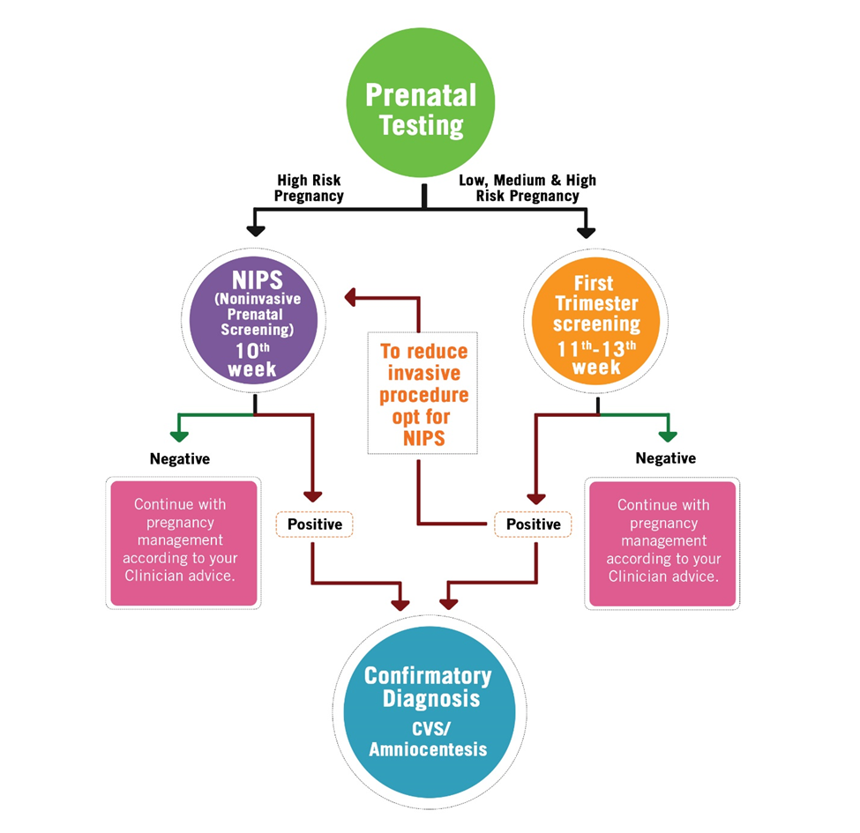
Diagram
The diagram below shows how diagnostic test and results are interpreted with appropriate measures to be taken.
https://cdnmedia.eurofins.com/clinicalgenetics/media/297509/nips_screening_flowchart.jpg?width=500&height=484.9585062240664

Slide 12
Predisposing factors during pregnancy
Predisposing factors are at the forefront of creating a high-risk pregnancy which threatens the health and life of the mother or her fetus.
To overcome these factors requires specialized prenatal care from specially trained providers (Bandara et al. 2019).
Some pregnancies are usually at a high risk as they develop, while some women are at increased risk for complications even before they get pregnant for different reasons.

Slide 13
CONT..
Early and regular prenatal care helps the majority of women to have healthy pregnancies and deliveries without complications.
These factors include; existing health conditions, like high blood pressure, diabetes, or being HIV-positive. Overweight and obesity.
Obesity increases the risk for high blood pressure, preeclampsia, gestational diabetes, stillbirth, neural tube defects, and cesarean delivery multiple births.

Slide 14
CONT..
The risk of complications is higher in women carrying more than one fetus (twins and higher-order multiples).
Bandara 2019 also suggested that common complications include preeclampsia, premature labour, and preterm birth. Young or old maternal age.
Pregnancy in teens and women age 35 or older increases the risk for preeclampsia and gestational high blood pressure.

Slide 15
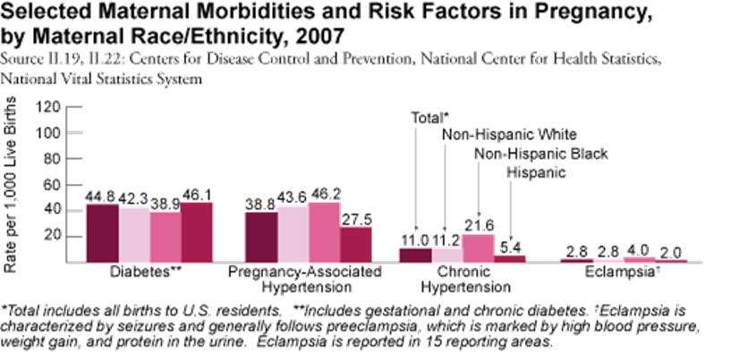
The graph below shows the various risk factors in pregnancy.
https://mchb.hrsa.gov/whusa10/hstat/mh/images/40MmVre.gif

Slide 16
Pathology in pregnancy
Pathology is an integral part of diagnosis and patient care in pregnancy, offering a range of pathology tests throughout the first, second and third trimesters (Tsunge et al. 2019).
Pathologists are there at the start, guiding appropriate testing, meeting the patient to procure tissue samples.
They also monitor quality of analysis, using specialist interpretive skills to make the diagnosis.

Slide 17
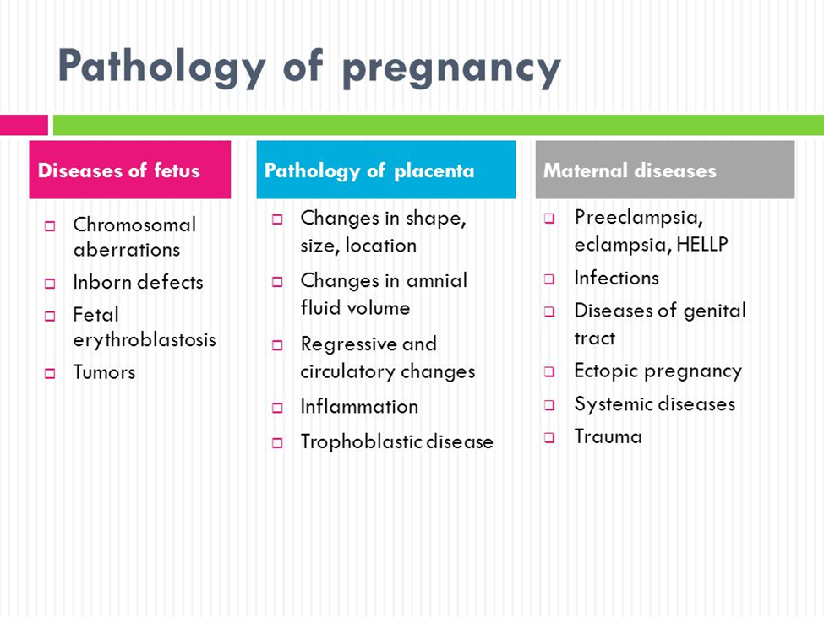
The diagram below shows the various diseases of fetus, pathology of placenta as well as maternal diseases.
https://slideplayer.com/slide/5257680/16/images/2/Pathology+of+pregnancy.jpg

Slide 18
CONT..
It helps them to define the prognosis and communicate this to the multidisciplinary teams of management, and finally they are able to follow the success of treatment through relevant monitoring.
Advancements in pathology have resulted in reduced maternal and neonatal morbidity and mortality.
From an understanding of the prevention of Rhesus disease through to the recognition of potentially infectious and genetic risk, pathology is instrumental in providing screening and monitoring tests to reduce harm to women and their babies (Tsunge et al. 2019).

Slide 19
BIBLIOGRAPHY
Bandara, H. M. H. N., & Samaranayake, L. P. (2019). Viral, bacterial, and fungal infections of the oral mucosa: Types, incidence, predisposing factors, diagnostic algorithms, and management. Periodontology 2000, 80(1), 148-176.
Cleveland Clinic, (2019). Article about: Pregnancy: Prenatal Care. https://my.clevelandclinic.org/health/articles/5181-pregnancy-prenatal-care. Retrieved 2019.
Department of Health, (2019). Article about: Diagnostic tests for your baby during pregnancy. https://healthywa.wa.gov.au/Articles/A_E/Diagnostic-tests-for-your-baby-during-pregnancy. Retrieved 2019.
Tchente Nguefack, C., Okalla Ebongue, C., Nouwen Chokotheu, C. et al. Clinical presentation, risk factors and pathogens involved in bacteriuria of pregnant women attending antenatal clinic of 3 hospitals in a developing country: a cross-sectional analytic study. BMC Pregnancy Childbirth 19, 143 (2019) doi: 10.1186/s12884-019-2290-y. https://bmcpregnancychildbirth.biomedcentral.com/articles/10.1186/s12884-019-2290-y. Retrieved 2019.
Tsuge, M., Hida, A. I., Minematsu, T., Honda, N., Oshiro, Y., Yokoyama, M., & Kondo, Y. (2019). A prospective cohort study of congenital cytomegalovirus infection during pregnancy with fetal growth restriction: serologic analysis and placental pathology. The Journal of paediatrics, 206, 42-48.

